Slide 1
Impact of ADC Loss in Different Hybrid Partial Product Shapes
B11901027 王仁軒
PPT TemplateCredit : Jie-Hong Roland Jiang

Slide 2
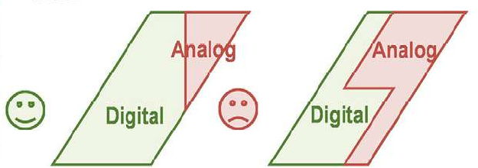
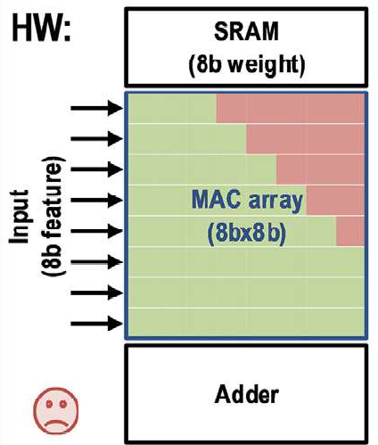
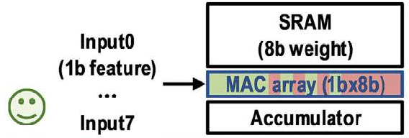
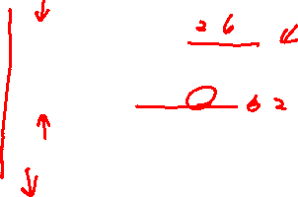
Recall
The definition of boundary between analog and digital part is a problem
Digital Part : High precision
Analog Part : Low precision
Digital Part : Bulky ckt
Analog Part : Less HW overhead

Slide 3
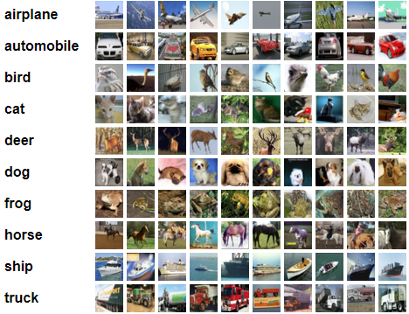
Flow
Part A : Analyze the effect of different partition method of partial sum
Lightning / Big-triangle / small-triangle
Part B : Use the result in part A to analyze the impact of analog loss on classification ML tasks
Analyze the characteristics of quantized CNN model
Apply the result in part A to the model
Resnet-18 on CIFAR-10

Slide 4

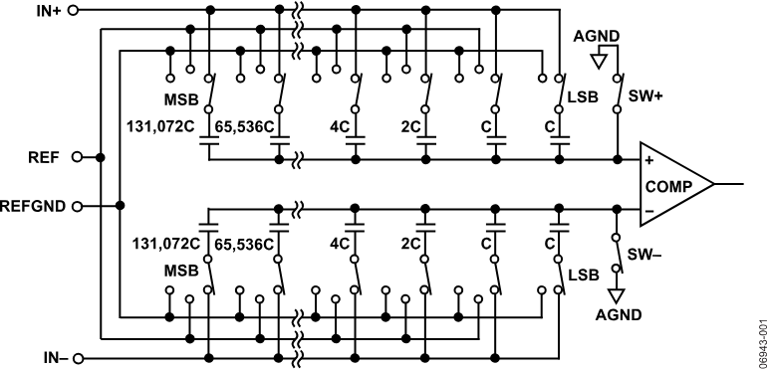
Part A : Shapes of Partial Sum
Digital Sum
Using digital multiplier and adder tree
Easy to simulate and calculate area
Analog Sum
Using analog multiplier and SAR ADC
SAR ADC implementation?
x n

Slide 5
Part A : Shapes of Partial Sum
Product = Digital sum + Analog Sum = Digital sum + Ideal Sum * loss
Digital sum
Analog sum

Slide 6
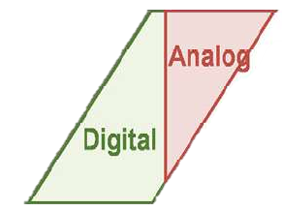
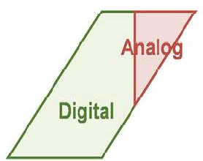
Part A : Shapes of Partial Sum
Types of Shapes
Lightning : Bit-serial scheme
Big triangle : Bit-rotation scheme
Small triangle : Bit parallel scheme
Lightning
Big Triangle
Small Triangle

Slide 7
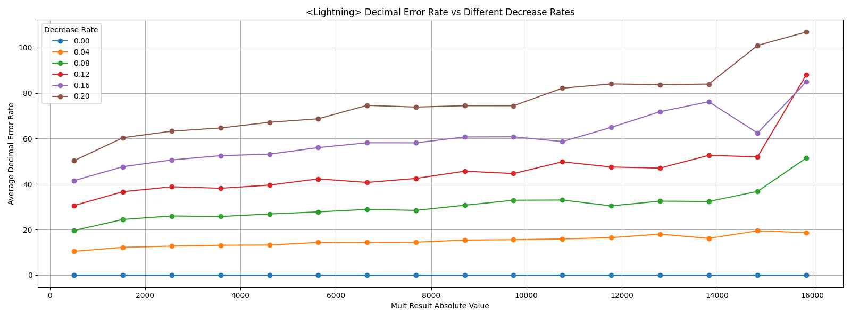
Part A : Shapes of Partial Sum
Lightning
Error in ADC
Error of its value
Analog loss

Slide 8
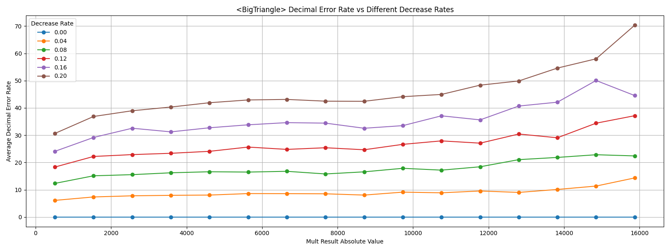
Part A : Shapes of Partial Sum
Big Triangle
Error in ADC
Error of its value
Analog loss

Slide 9
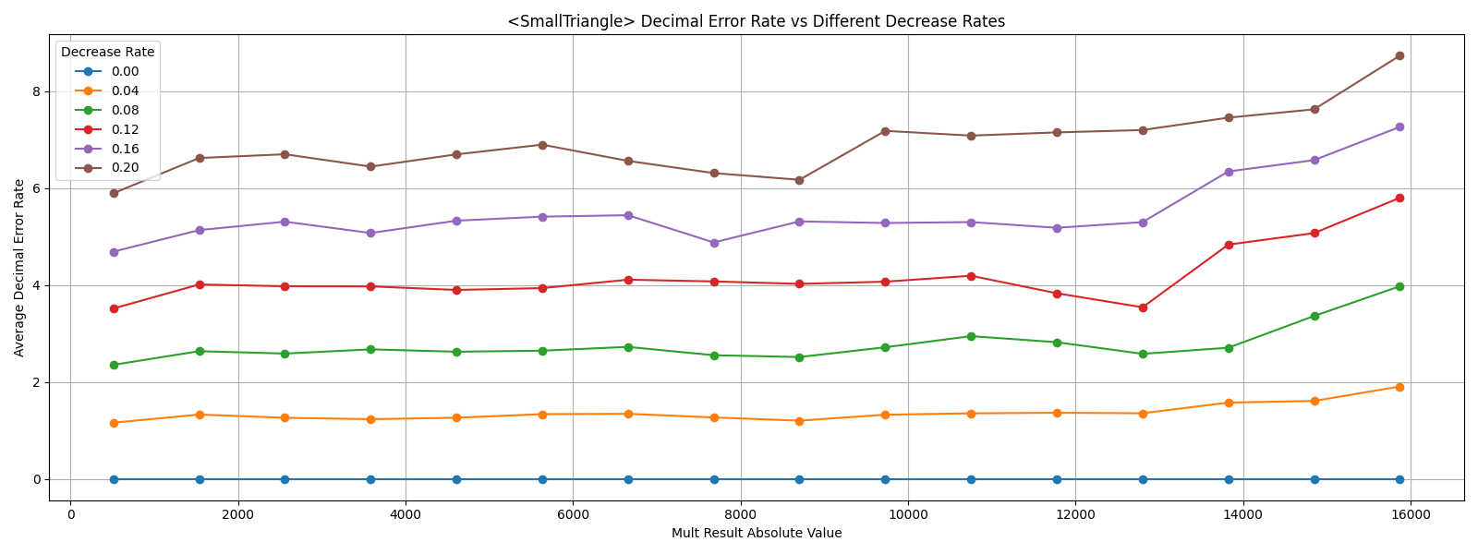
Part A : Shapes of Partial Sum
Small Triangle
Error in ADC
Error of its value
Analog loss

Slide 10
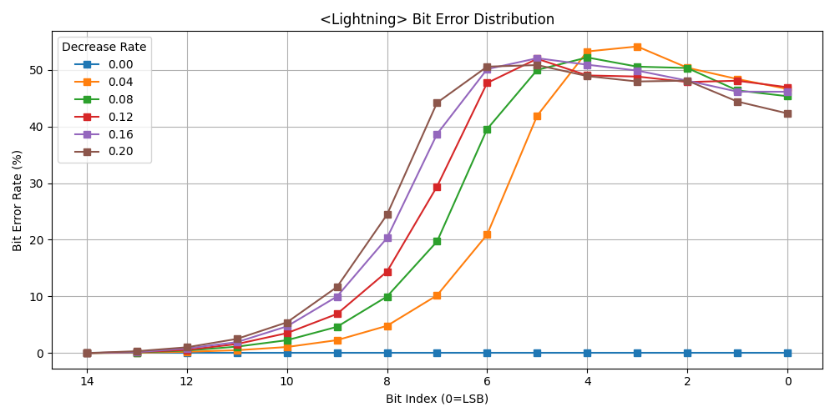
Part A : Shapes of Partial Sum
Lightning
Error in ADC
Error rate in bits
Analog loss

Slide 11
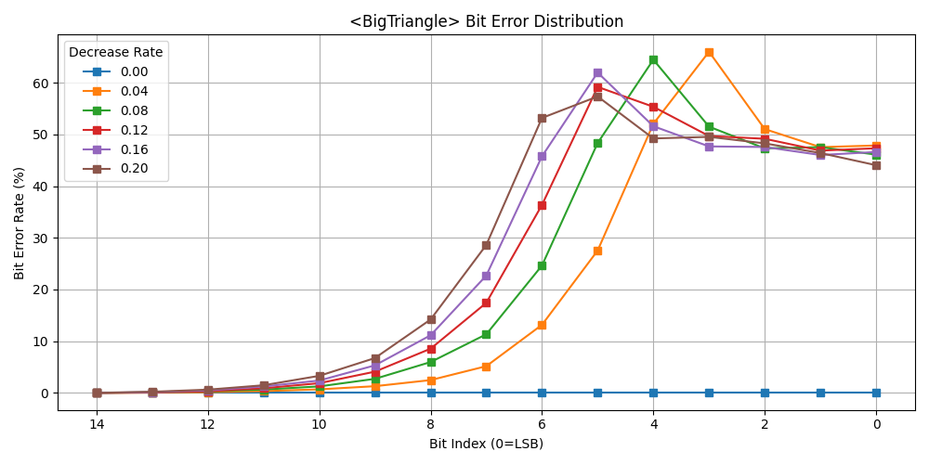
Part A : Shapes of Partial Sum
Big Triangle
Error in ADC
Error rate in bits
Analog loss

Slide 12
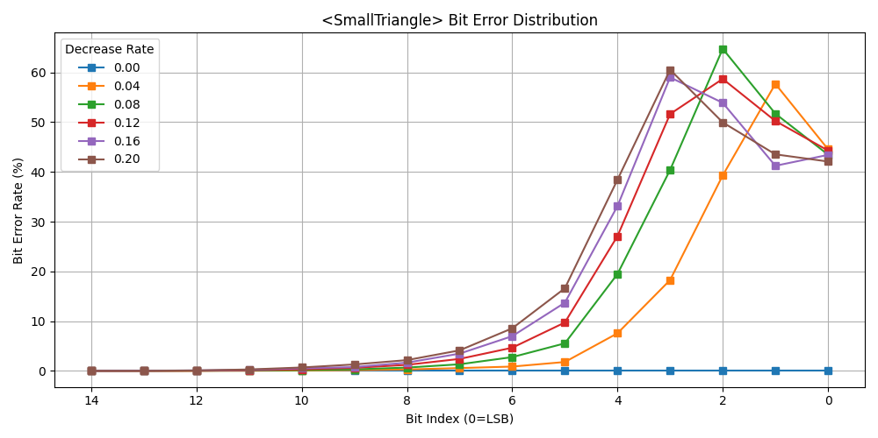
Part A : Shapes of Partial Sum
Small Triangle
Error in ADC
Error rate in bits
Analog loss

Slide 13
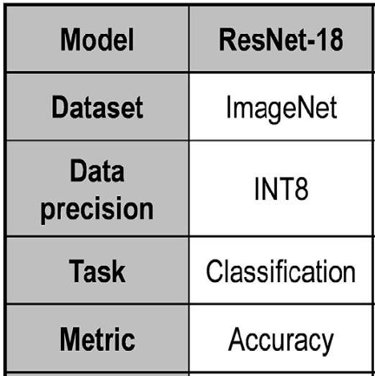
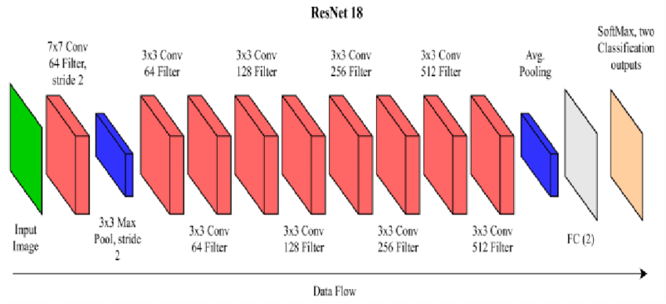
Part B : Impact of Analog Loss
The dataset used in the paper is ImageNet
ImageNet is not implemented in torch
Use a simpler dataset CIFAR-10
ResNet-18
Trained using fp precision
Quantize to int8 after training
Compute MAC result for each layer and apply loss
-LOSS
Gaussian(-Loss,0.01)

Slide 14
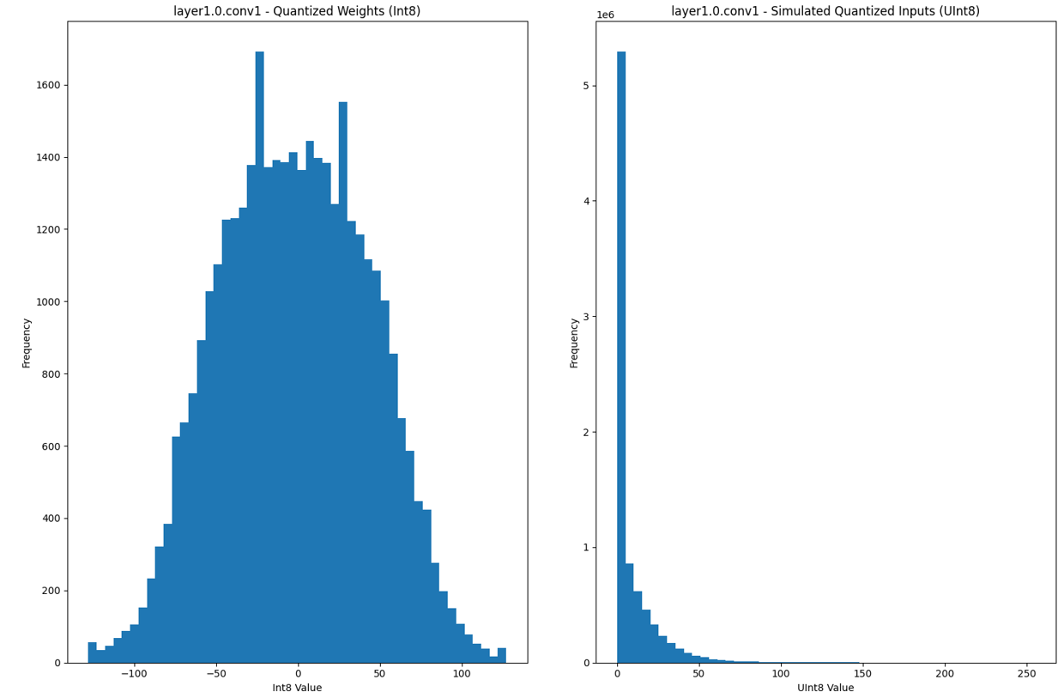

Part B : Impact of Analog Loss
Analysis of the quantized model
Most of the quantized weight are within $±100$
Most of the quantized input activation < 50
MAC result are within $±5000$
Analog loss
Use the result of this part

Slide 15
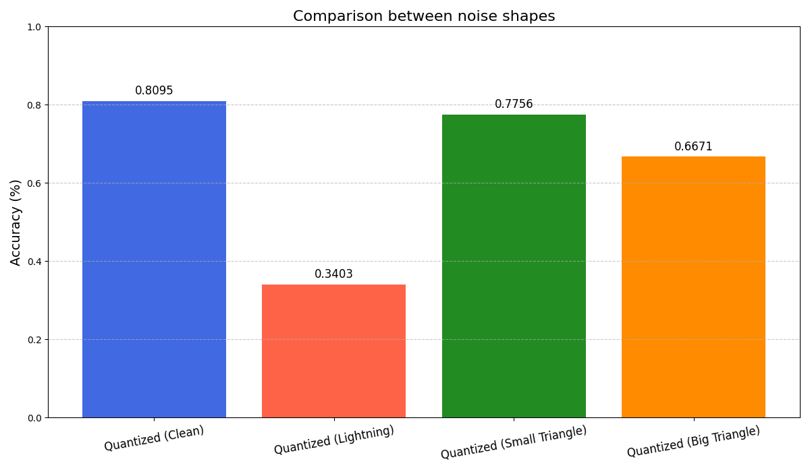
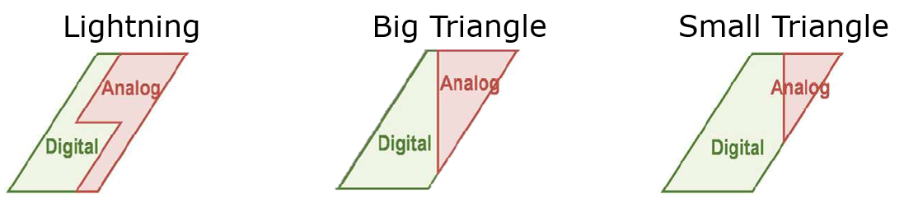

Part B : Impact of Analog Loss
Accuracy drop of ResNet-18 if loss is applied
What about area of ckt?
Lightning : bit-serial : 2x3 FA + 15 FA and 1 shift + 32C
Small $Δ$: bit-parallel : 49 FA + 130C
Big $Δ$: bit-rotate : 2x3 FA + 15 FA and 1 shift + 8C
58% drop
4% drop
18% drop
Sign bit
processing
Sum the product
Bit precision
alignment
Analog
Sum

Slide 16
Conclusion
Comparison between different shapes
Lightning
Big Triangle
Small Triangle
Decimal Loss (0.1 Loss) | 36 | 20 | 3.5
Accuracy | Large drop (58%) | Acceptable drop (18%) | Low drop (4%)
Adder Area | 21 FA | 21 FA | 49 FA
Capacitors Used | 32 C | 8 C | 130 C

